Slide 1



Anti-Bullying at Nursteed

Slide 2
What is bullying?

Slide 3
What is bullying?
“
Bullying is the repetitive, intentional hurting of one person or group by another person or group, where the relationship involves an imbalance of power. It can happen face to face or online.
“

Slide 4

At Nursteed we refer to bullying as something that happens:
Several
Times
On
Purpose

Slide 5
What is the difference between bullying and an argument?

Slide 6
Our most important job in school is to keep you safe, happy and healthy
We will protect you from harm
We will look after you
We will help you if something is wrong (at home or in school)

Slide 7
Who is a trusted adult for you in school?

Slide 8
Who might be involved in a bullying incident?
How many people?
Is it always just two?

Slide 9



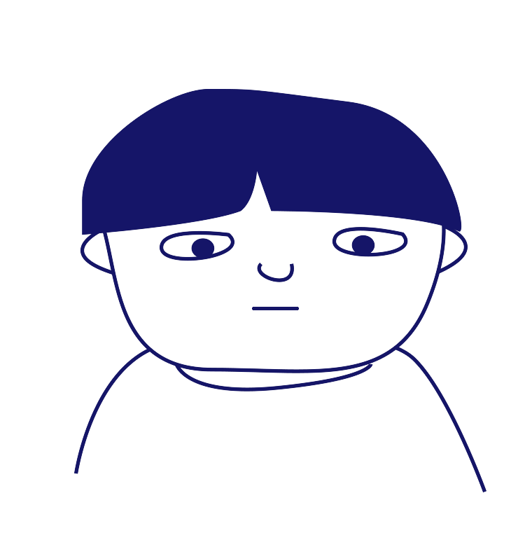
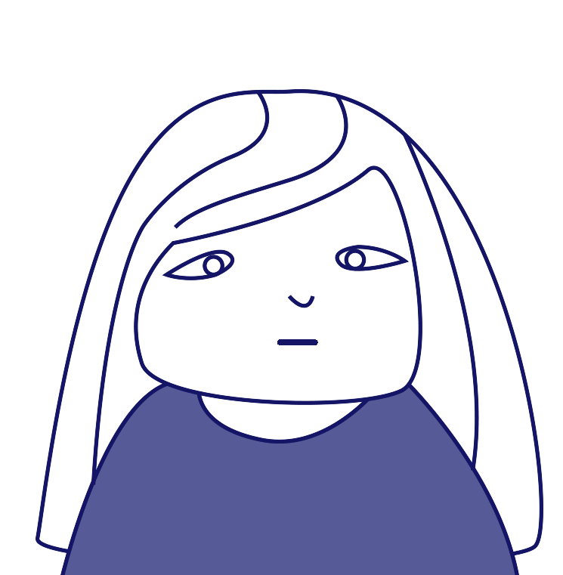
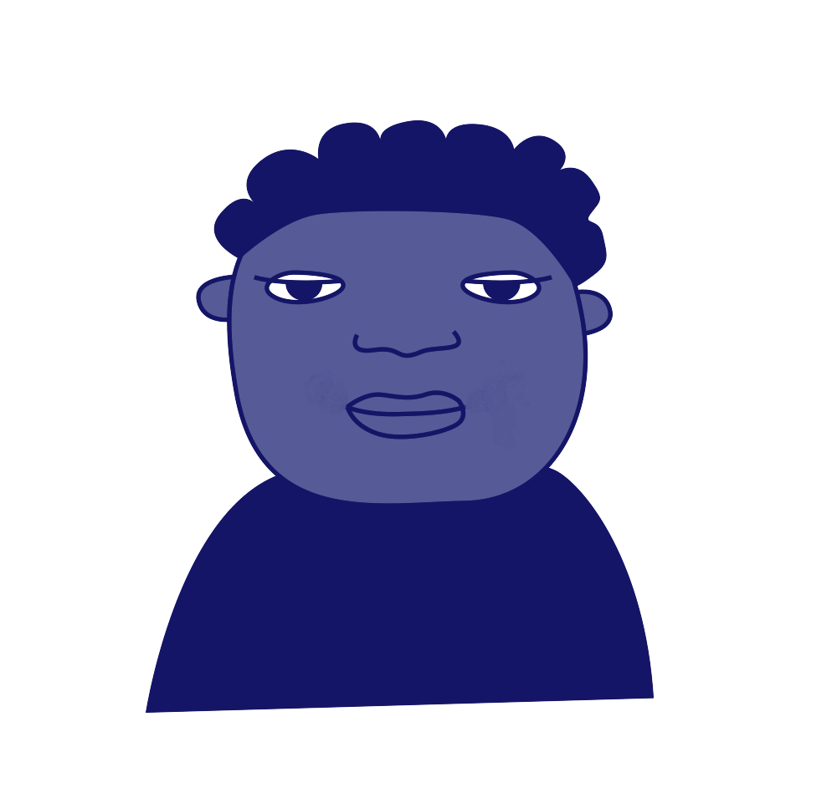
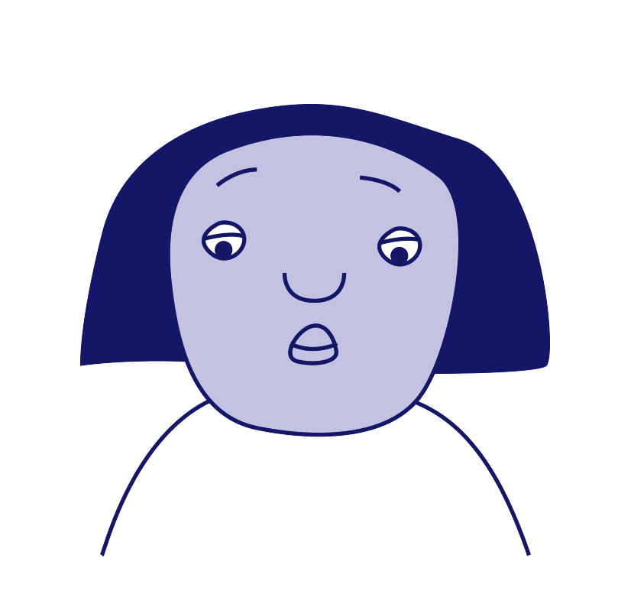
Roles involved in bullying
‘Ringleader’
‘Assistant’
‘Target’
‘Outsider’ or ‘Bystander’
‘Defender’
‘Reinforcer’

Slide 10

Scenario
Whenever Janai joins an online game on her PlayStation with her classmates, Dylan always tells other children to leave the game and start a new one without her.
Which roles can you see in this scenario? How could each person reach out?

Slide 11
Leaflet

